Slide 1
GARDEN PROJECT WORKFLOW
REVIT University
MULTIPLE BUILDING WORKFLOW
ORB UNIVERSITY – MAY 09, 2023
PRESENTED BY Andres Fernandez, Christian Quintero

Slide 2
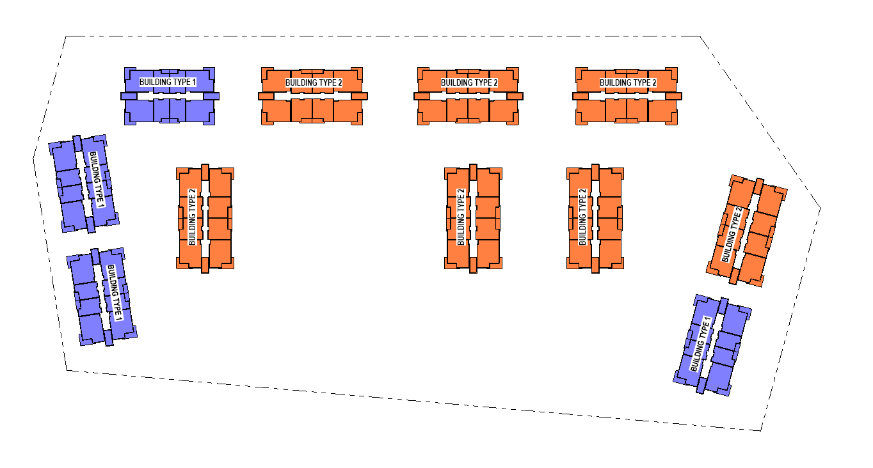
GARDEN STYLE PROJECTS
Garden style projects consist of two to three story independent buildings. Typically these buildings are of type VA construction, will not require an elevator and each building can be present multiple times on the same site. Refer to ORB University for Chapters 5 & 6. Multiple buildings provide easy repetition and design consistency throughout the site while avoiding one-off conditions.

Slide 3
SINGLE BUILDING PROJECT WORKFLOW
Site Plan
Floor Plans
Reflected Ceiling Plans
Roof Plans
Exterior Elevations
Building Sections
Wall Sections
Enlarged Plans
Stairs
Elevators
Storage
Keynotes
Enlarged plan callouts
Building Section callouts
Wall Section callouts
Detail callouts
RVT Unit Tags,
Unit wall tags
Unit Door tags
FLOOR PLAN LINKED*
ANSI PLAN LINKED*
DD PLAN LINKED*
INTERIOR ELEVATIONS*
UNIT TYPES
1 THRU 5
BUILDING FILE
UNIT TYPES
6 THRU 10

Slide 4
GARDEN PROJECT WORKFLOW
Site Plan
Life Safety Site Plan
Keynotes
Enlarged plan callouts*
Building Section callouts*
Wall Section callouts*
Detail callouts
RVT Unit Tags,
Unit wall tags
Unit Door tags
DOCUMENTATION FILE
Floor Plans
Reflected Ceiling Plans
Roof Plans
Exterior Elevations
Building Sections
Wall Sections
Enlarged Plans
Stairs
Elevators
Storage
FLOOR PLAN LINKED*
ANSI PLAN LINKED*
DD PLAN LINKED*
INTERIOR ELEVATIONS*
BUILDING TYPE 1
BUILDING TYPE 2
UNIT TYPES
1 THRU 5
UNIT TYPES
6 THRU 10
* These views are first created in the individual files and then brought over via linked views

Slide 5
LINKING SCHEMA
DOCUMENTATION FILE
BUILDING TYPE 1
BUILDING TYPE 2
SURVEY FILE
RVT CONSULTANTS
UNIT A2
UNIT B1
UNIT C3
STRUCTURAL
MPE
LIGHTING
INTERIORS
UNIT FILES
KEYNOTE FILE
ATTACHMENT
OVERLAY
The documentation file is where the information for the project is referenced and memorialized.

Slide 6
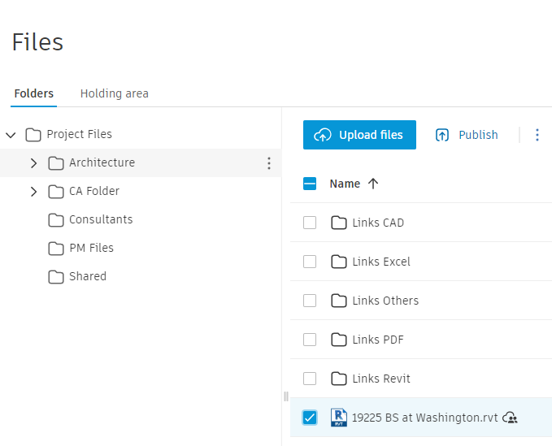
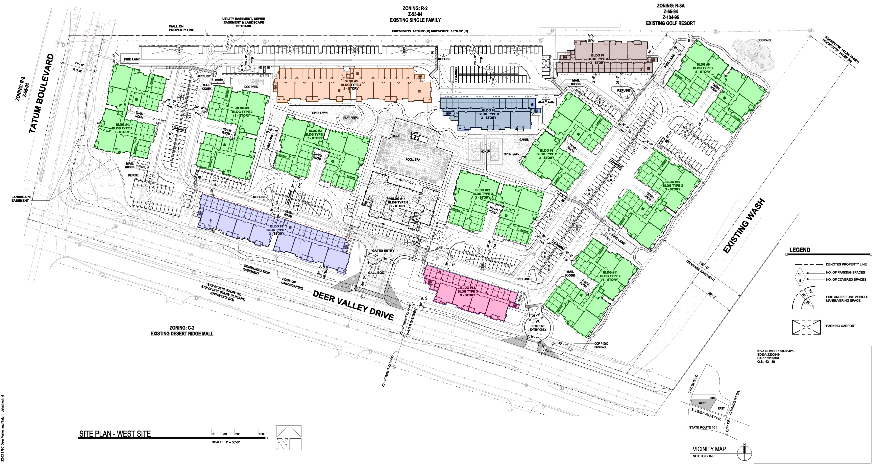
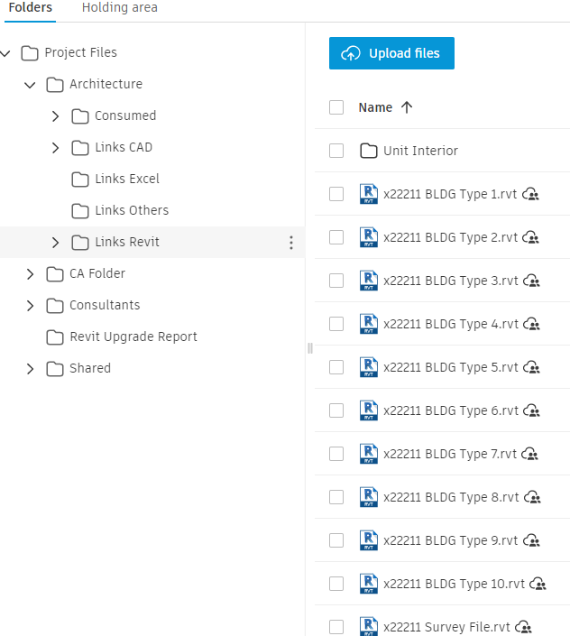
Building Type Files

Slide 7
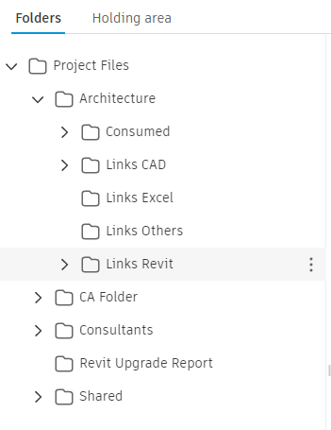
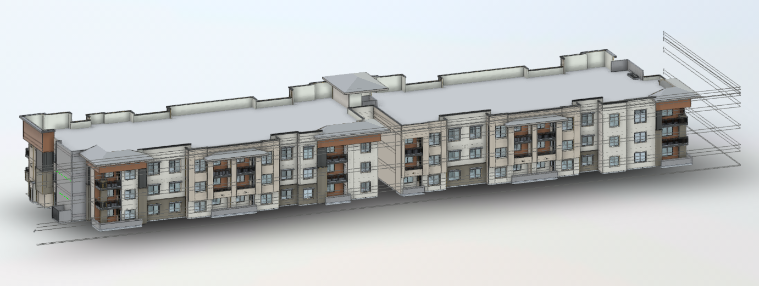
BUILDING TYPE FILES
Floor Plans
Reflected Ceiling Plans
Roof Plans
Exterior Elevations
Building Sections
Wall Sections
Enlarged Plans
Stairs
Elevators
Storage
OVERLAYED
UNITS

Slide 8
BUILDING TYPE FILES
Building type Documentation:
Floor Plans
Gridlines (if applicable)
Dimensions
Assembly tags
Detail lines (center line style) for center line of demising wall between units
Labeled reference planes that will coincide with Building Sections. Rename the reference plane to match the specific building section.
Reference lines to show where wall sections for the building will take place.
Rooms (where applicable), provide room tags
Door tags
Enlarged plan callouts
Enlarged stair plans & sections
Enlarged elevator plans & sections
Enlarged storage areas
Building type Documentation:
Reflected Ceiling Plans
Dimensions
Ceiling assembly tags
Height callouts for drop ceilings
Building type Documentation:
Roof Plans (Overall & Enlarged)
Dimensions
Parapet heights
Slope arrows
Building type Documentation:
Exterior Elevations
Dimensions (where applicable)
Material Tags
Building Sections
Dimensions
Assembly tags
Detail components if applicable

Slide 9
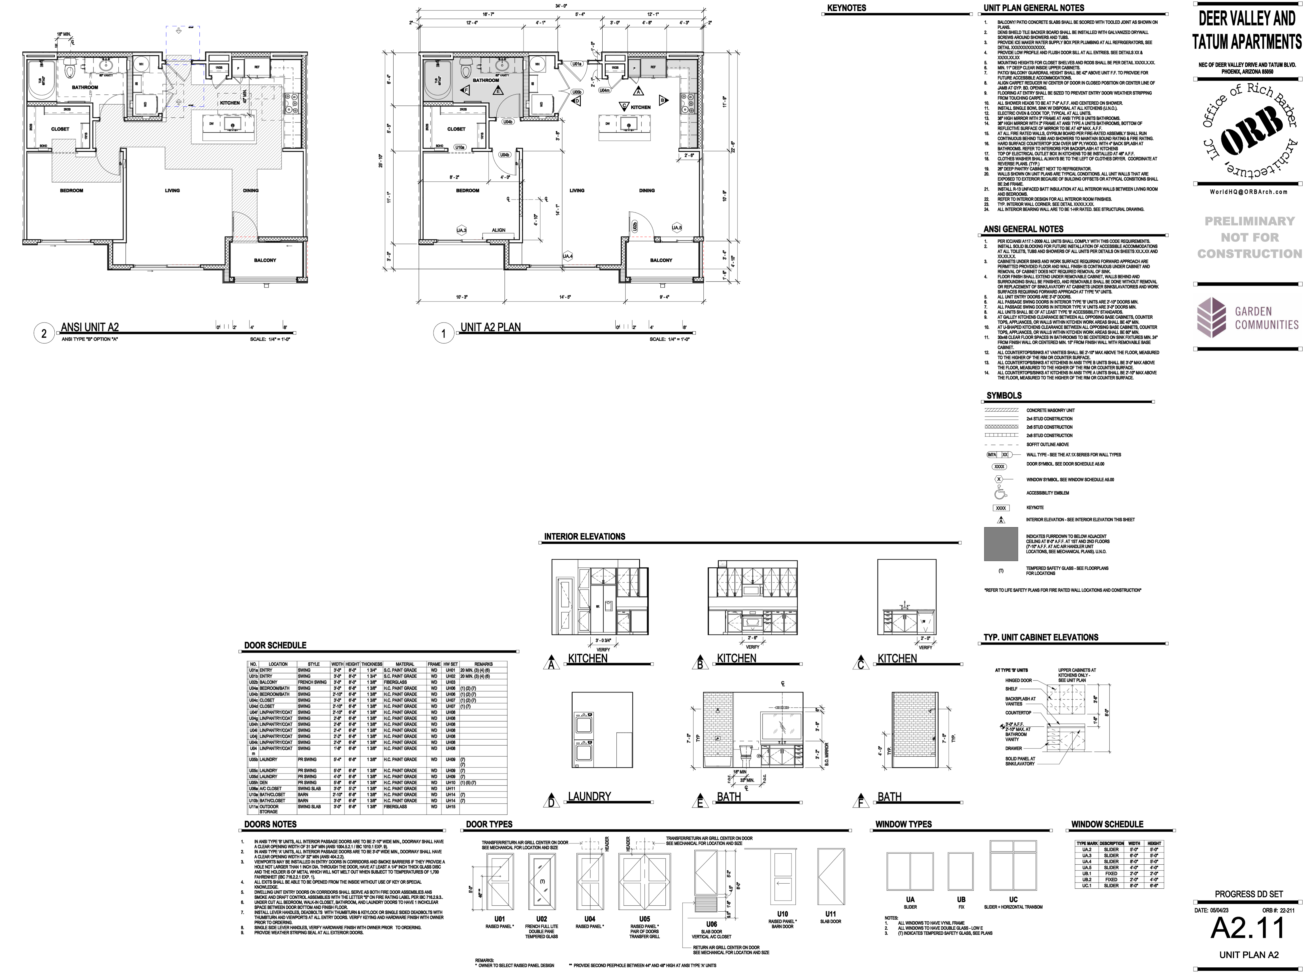
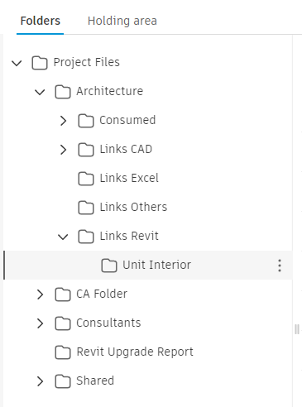
UNIT TYPE FILES
BUILDING FILE
DOCUMENTATION FILE
Unit Type files will always be independent. No files are to be linked inside of a unit type file.
The relevant units will be linked to their designated building type as overlays and all units will also be linked as attachments to the documentation file to create the unit farm. It is important to follow these guidelines so that pre-set schedules, view templates and worksets in the documentation file function correctly.

Slide 10
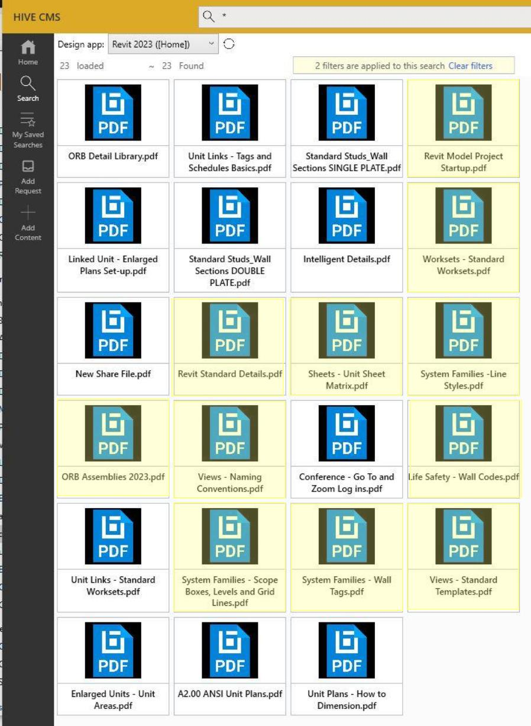
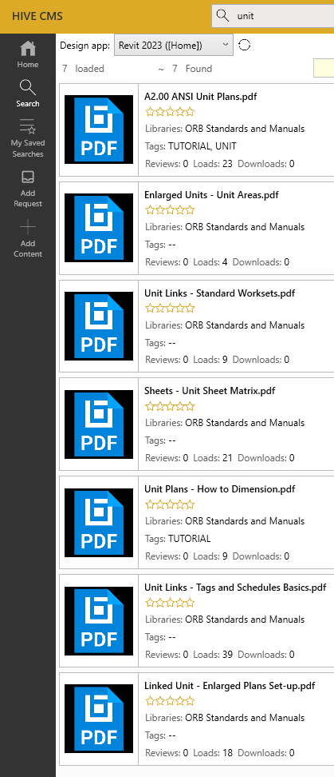
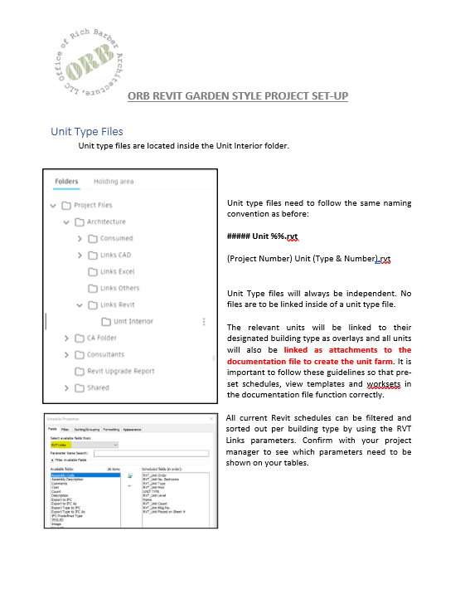
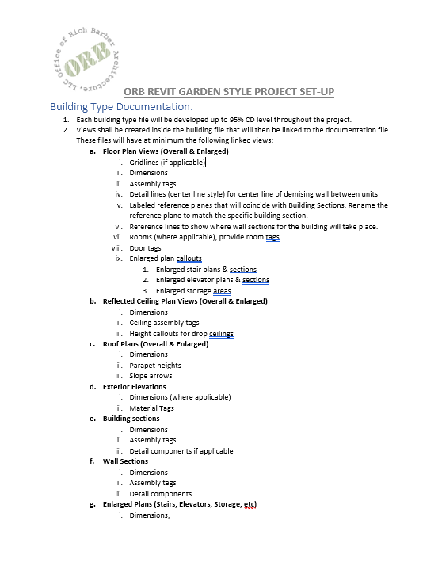
RESOURCES
HIVE:
SEARCH LIBRARY:
ORB Standards and Manuals
Revit Garden Style Project Set-Up

